Slide 1
Documents and Archives
Doing Political Research

Slide 2
What Documents Can We Analyse?
Anything! (related to our research question)
Texts: Historical manuscripts, personal papers, official documents, news media, social media posts
Also: photographs, pictures, cartoons, videos, graffiti, films and TV

Slide 3

Questions to Ask of Documents (Bryman)
Authenticity: Is the evidence genuine and of clear origin?
Credibility: Is the evidence free from error and distortion?
Representativeness: Is the evidence typical of its kind? Of not, is the extent of its untypicality known?
Meaning: Is the evidence clear and comprehensible?

Slide 4
Methods for Analysing Documents
Quantitative content analysis
Coding of documents according to a set of themes, use of quantitative analysis
Coding schemes usually set deductively
Semiotics
The study of signs
Uncovering how meaning is produced and how signs are designed to convey meaning
Ethnographic content analysis
Focus on interpretation
Use of inductive coding

Slide 5
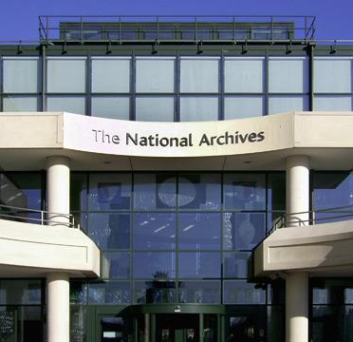
Historical Archives
Researching historical events usually requires accessing archives
Where? Libraries, private collections, formal archives
Systems of archiving structure how sources can (not) be found
Threat of confirmation bias if we only look for materials which accord with our theory
What is the ‘universe’ of archives we could look at? Often unknown

Slide 6
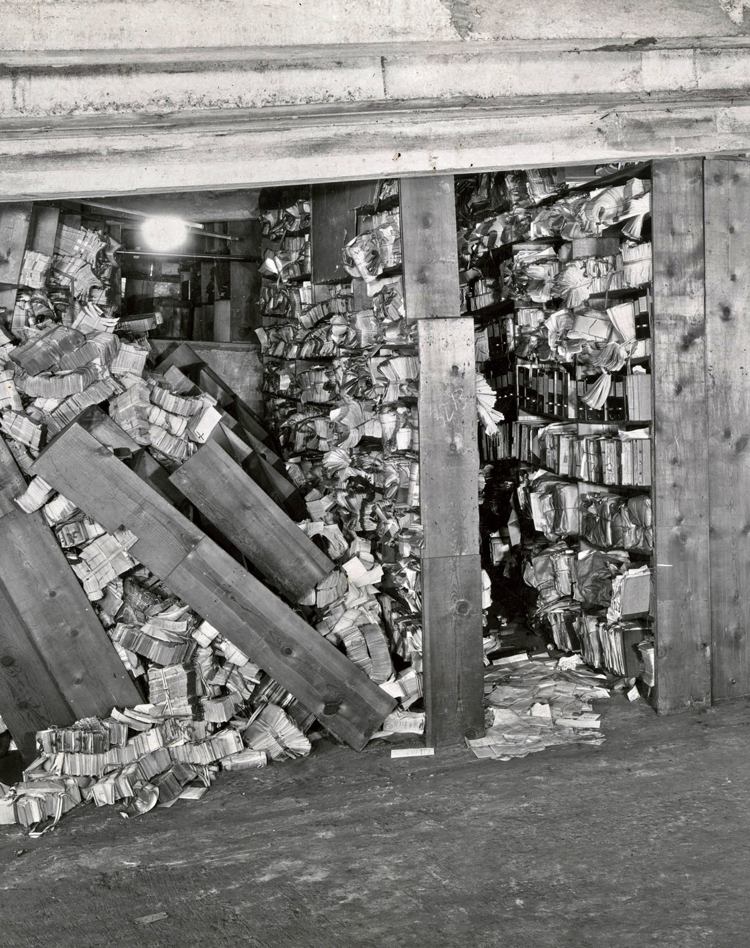
Sources of Bias in Archives (Lee)
Source bias
What kinds of documents were produced in the first place?
Transfer bias
Which documents have been made available to researchers?
MI5 has released no material since the 1950s
Survival bias
Which documents have survived the passage of time?
Archives can be destroyed by fires, floors, neglect and thievery
Those considered more important are more likely to be conserved

Slide 8
Good Practice in Archival Research (Lee)
Create a sampling frame
Which kinds of documents could help prove or disprove your hypotheses?
Read a random sample of both kinds of documents
Or else read all extant documents of a certain class eg Blaydes (2018) read all school reports on political reliability in a certain year in Iraq under Saddam Hussein
Understand how and why material was created
Who wrote it? Who read it?
What was the purpose of writing it?
What is the history of the archive?
Provide context of the archives for readers

Slide 9
Good Practice in Content Analysis
Same principles as approaching historical archives, but clarity on method of analysis is crucial too
What documents were included/excluded? To what extent are these a representative sample of the universe of documents?
Was the coding scheme derived deductively or inductively?
What was the coding scheme?
Who coded the data? How were differences in coding adjudicated?

Slide 10
A Coding Scheme for Crime Reports in Local Newspapers (Bryman)

Slide 11
Quantitative Content Analysis: Topics of News Coverage in Syria State-Controlled Media (Alrababa’h and Blaydes 2021)

Slide 12
Ethnographic Content Analysis: Symbols of Domination and Resistance in Syria (Wedeen 1999)
Few formal archives exist or can be accessed
Interviews can be dangerous
Focus instead on visual culture

Slide 13
Conclusion
Archives and documents are crucial data sources for case studies and historical research
But we must reflect on all the potential sources of bias
What documents were produced, why were they produced and what survives?
What don’t we see in the archive?
Content analysis is a powerful method
Think systematically about how you will approach it
Be clear about how you conducted the analysis

